Slide 1
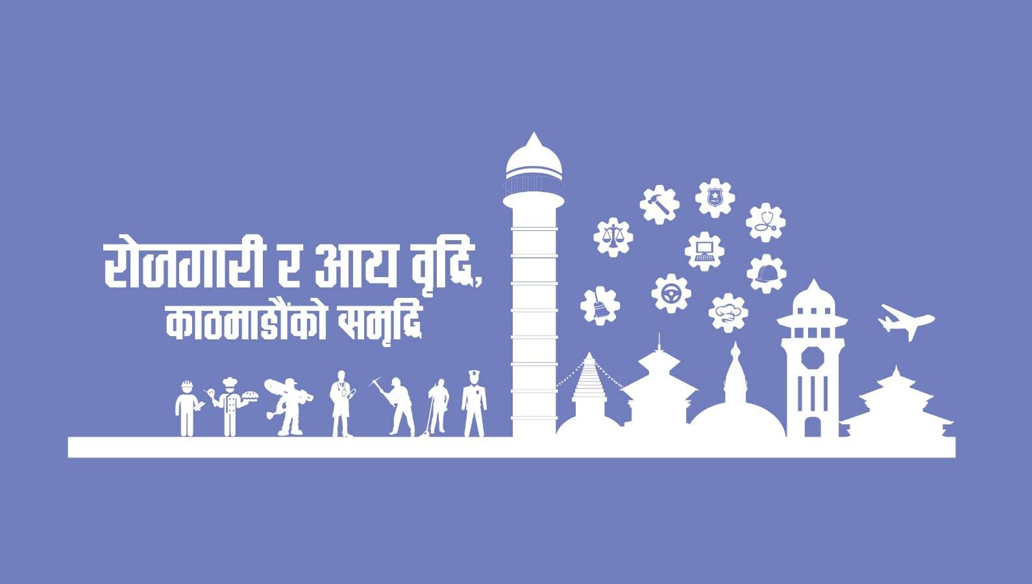
Welcome to the AI Training Program

Slide 2
Meet Your Mentor – Mr. Prince Karna
Educator | AI & IT Professional | Youth Mentor | Project Supervisor | Social Activist
Key Highlights:
- Supervised AI/ML projects (chatbots, image classifiers, etc.)
- EMIS & IT Officer at Kathmandu Model College-TU
- Led student tech events, hackathons, and innovation challenges
- Collaborated with NGOs/INGOs on tech for good
- Skilled in Python, Scikit-learn, TensorFlow, GitHub, etc.
Notes:
"Namaste everyone! I'm Prince Karna, and I'm thrilled to embark on this AI journey with you. With a Master's in Computer Science and Information Technology Management, I've dedicated my career to the intersection of technology, education, and social impact.
Over the years, I've served as an EMIS and IT Officer at Kathmandu Model College, where I managed educational data systems and integrated technology into academic processes. My passion for teaching has led me to mentor and tutor numerous students, guiding them through complex AI and ML concepts.
One of my most fulfilling roles has been supervising final-year projects focused on AI and ML. Witnessing students transform ideas into functional AI applications—like predictive models and intelligent systems—has been incredibly rewarding.
Beyond academia, I'm actively involved in social initiatives, collaborating with NGOs and INGOs to leverage technology for community development. I believe that AI isn't just about algorithms; it's a tool to drive meaningful change.
In this training, we'll explore AI's vast landscape, from foundational concepts to real-world applications. My goal is to equip you with the skills and mindset to innovate and make a difference.
Let's dive in and shape the future together!"

Slide 3
My AI Journey
Started with a passion for coding and education
Explored AI through teaching, mentoring, and projects
Learned by doing – building real applications
Believe AI is a tool for transformation
Now sharing that knowledge to inspire youth

Slide 4
Why AI, Why Now?
AI is transforming industries globally
From self-driving cars to YouTube suggestions – it's everywhere
AI is a future-proof skill with global demand
Nepal needs creators and solvers – that's YOU
“You're not just learning to code – you're learning to create the future.”

Slide 5
Training Roadmap
Intro to AI, ML & Data …….. Understand fundamentals & Python
Machine Learning Basics…….Build your first ML model
Deep Learning & Neural Nets....Understand CNNs & intro to NLP
AI Applications + Final Project……. Build real-world AI solutions
- Mix of theory & hands-on work
- Weekly assignments, Fun & final showcase

Slide 6
Introduction to AI
- What is AI?
- Machines that mimic human intelligence
Types of AI:
- Narrow AI (e.g., Siri, Google Maps)
- General AI (human-like, future)
- Super AI (superior to humans)
Fields:
- ML, NLP, Computer Vision, Robotics
Examples:
- ChatGPT, Netflix, Google Photos, Hospitals, Self-driving cars
Notes:
Real-World Use Cases:
ChatGPT, Siri – Natural language understanding
Netflix, YouTube – Recommendation engines
Google Photos – Face and object recognition
Hospitals – Predictive diagnosis
Finance – Fraud detection
Self-driving cars – Vision + decision making

Slide 7
How do you think AI could change your life or the world around you?
https://youtu.be/RNnZwvklwa8?si=kZkNU2F17NkwjgqE
Notes:
‘How do you think AI could change your life or the world around you?’"
"Keep that question in mind as you watch — see if the video sparks new ideas or inspirations for you."
"Also, notice the power and potential AI holds—not just as a technology, but as a tool for creating solutions."
What stood out to you in the video? Any surprises or new thoughts?"
"AI isn’t just about coding or algorithms — it’s about what you can do with it. Every innovation begins with a vision, and each of you has the potential to be that visionary."
"Remember, AI is shaping every industry — healthcare, education, entertainment, and more. You’re here because you want to be part of this transformation."
"Keep your curiosity alive. This training is your first step to turning that power of AI into real-world impact."

Slide 8
Icebreaker Activity
💡 Discuss: 'If you could solve one problem using AI, what would it be?'

Slide 9
How can AI help people work better and smarter rather than replace them?
https://youtu.be/FwOTs4UxQS4?si=WvrrgyZficA0Lxj_
Notes:
Focus on the positive ways AI can enhance our skills and improve workplaces, especially in fields you care about.”
“This video will show you how AI is not just technology — it’s a tool to empower human potential.”
Notice how AI can amplify human creativity, not just automate tasks. This is the future of work — collaboration between humans and machines.”
“AI opens doors to new jobs and opportunities we haven’t imagined yet. Your role as learners is to be innovators who shape this future positively.”
“As we continue, think about how you can leverage AI for good — in your communities, industries, and beyond.”

Slide 10
AI Ethics & Responsibility
Notes:
AI systems make decisions that can impact real people — like who gets a job, a loan, or even medical treatment.
If the data or logic is biased, the results can be unfair.
Real Examples of Misuse:
Facial Recognition Bias: Some systems had higher error rates for people with darker skin tones because of biased training data.
Hiring Algorithms: AI used by companies like Amazon favored male candidates because past data showed male-dominated hires.
🛡️ How to Avoid These Issues:
Always question the data — who collected it, and what biases might it include?
Include diverse teams when building AI tools.
Practice transparency — let users understand how decisions are made.

Slide 11
AI Can Be Creative and Fun
“AI isn’t just about logic and numbers — it’s also about imagination. You can use it to create, express, and innovate.”
Notes:
Art: DALL·E and DeepArt create AI-generated paintings
Music: OpenAI’s MuseNet composes music in different styles
Storytelling: ChatGPT writes poems, scripts, or full novels
Gaming: AI bots that learn to play complex video games (like Dota or Minecraft)

Slide 12
Wrap-Up & Expectations
- Show up daily with curiosity
- Respect all opinions
- Help each other
- No judgment zone
Final Goal: Build something you're proud of by the end!

Slide 13
Let's Begin!
You're not just learning AI—you’re preparing to shape the future.

